Slide 1
Particulars and Project Information
STUDENT NAME: Wenseslaus Kidakule
REGISTRATION NO: NIT/BCS/2023/521
SUPERVISOR NAME: Miss Glory Malamsha
TITLE: DEVELOPMENT OF LOGISTICS ANALYSIS TOOL FOR FUEL PRICES PREDICTION.
TYPE: Data Science and AI/ML Project

Slide 2
Background
Fuel prices play a critical role in deciding the efficiency and sustainability of logistics operations globally, In Tanzania and across many developing economies, fluctuations in fuel costs directly influence transportation expenses, supply chain reliability and uncertainty in budgeting, There is a need for predicting upcoming fuel prices for effective planning.

Slide 3
Problem Statement
Currently, many fuel station operators and logistics companies rely on manual estimations to manage fuel-related costs. This lack of predictive capability leads to poor budgeting, inefficient route planning, and reduced competitiveness.

Slide 4
Significance of the Project
Provides operational efficiency in fuel and logistics companies
Enables Risk mitigation by preparing users for fuel prices fluctuation
Enhance data driven decision making
Helps in sustainability and resources optimization
Facilitates technological advancement

Slide 5
Main Objective
To Develop a web-based logistics analysis tool that uses fuel prices data to make analysis, data visualization and future fuel price prediction through machine learning models.

Slide 6
Specific Objectives
Data collection and cleaning
Data analysis and visualization
Development of prediction model based on fuel prices
Design a user friendly web based interface
Decision making insights according to prediction results.

Slide 7
Scope of the Project
This project will focus on fuel price analysis and prediction , and predictions will be from short to medium terms(one month to four months) only.
It will not deal with other logistics functions as routes and it will not cover long term predictions like semi-annually or annually.

Slide 8
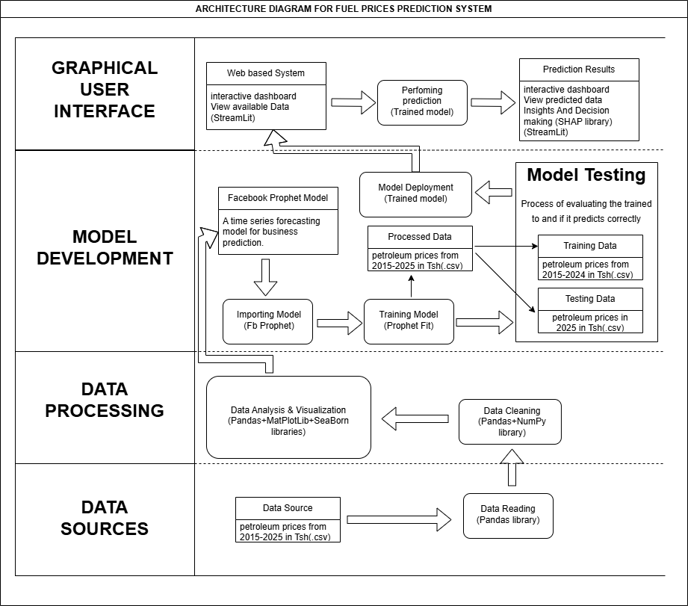
SYSTEM ARCHITECTURE DIAGRAM

Slide 9
SYSTEM ARCHITECTURE DIAGRAM Cont…

Slide 10
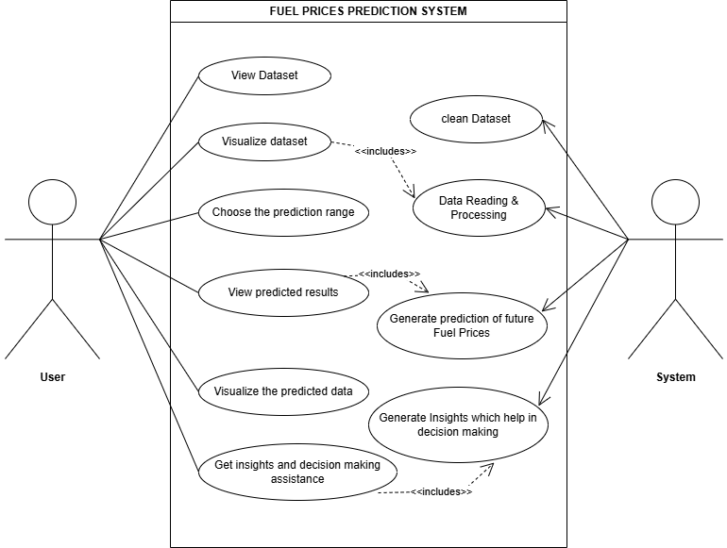
USE CASE DIAGRAM

Slide 11
USE CASE DIAGRAM Cont…

Slide 12
Literature Review
1. Introduction
In Tanzania, several researches have been done on prediction of petrol and diesel prices by using different machine learning models especially ARIMA model, globally systems have been made to implement the prediction process through secondary data.
This literature review discusses existing researches and systems related to the project and identifies gaps that this project aims to address.

Slide 13
Literature review cont…
2. Review of Existing Studies and Systems
Ntare p.c(2023) conducted a scientific research on developing fuel prices prediction model where by his findings concluded that ARIMA(p,d,q) was the best model in prediction by using secondary data(2012-2022) due its accuracy.
Gasper Laban and Mbwambo Haika(2023) also conducted a research on determining the problem of predicting crude oil prices in a situation of unusual circumstances, where they concluded that the model must be updated to accurately predict the prices in exceptional circumstances

Slide 14
Literature review cont…
Also Swoyam Siddharth Nayak(2023) developed the oil and gas prices prediction system in US dollars, The project focused on creating models to predict the closing prices of these fuels based on their opening, highest, and lowest prices then designed a html pages for user interaction to the system.

Slide 15
Literature review cont…
3. Identified gaps in existing researches and systems;
From the local reviewed literature, it shows that in Tanzania there are only prediction models but no complete systems have been officially published.
All prediction models based on ARIMA model which is less flexible for irregular or missing data.
Secondary data used are not recently (2022)
From The global reviewed literature, the systems have already been made but price prediction bases on USD currency.

Slide 16
Literature review cont…
4. Relation to the proposed project;
The proposed logistics data analysis tool aims to address the identified gaps by providing;
User friendly system based in Tanzania with easy to use features.
Secondary data that are updated (2015 - 2025)
Prediction model based on Prophet Time-series forecasting Model which is more accurate for business forecasting.
Price prediction in Tanzania Shillings (Tsh)

Slide 17
Literature review cont…
5. Conclusion
By applying these additional features to my project, the logistics analysis system will be improved in terms of price prediction accuracy, user friendly interface, reusability, and local based price predictions.

Slide 18
REFFERENCES
Ntare, P.C. Department of Mathematics and ICT, College of Business Education, Tanzania.
privatus.ntare@cbe.ac.tz
Gasper, L., & Mbwambo, H. (2023). Forecasting crude oil prices by using ARIMA model : evidence from Tanzania. Journal of Accounting, Finance and Auditing Studies, 9(2), 158-175.
Swoyan s.n(2023). https://github.com/swoyam2609/Oil-and-Gas-Price-Analysis-and-Prediction
EWURA official website. https://www.ewura.go.tz/publications/petroleum-price

Slide 19
Q&A
Thank you for your attention.
I welcome any questions or suggestions regarding this project.

